Slide 1
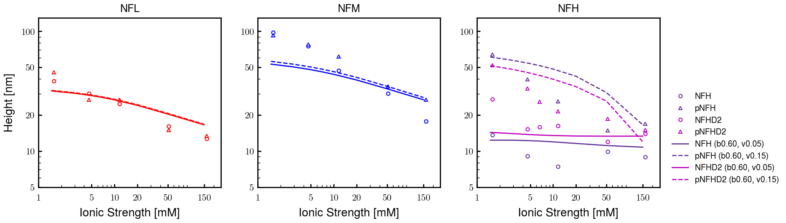
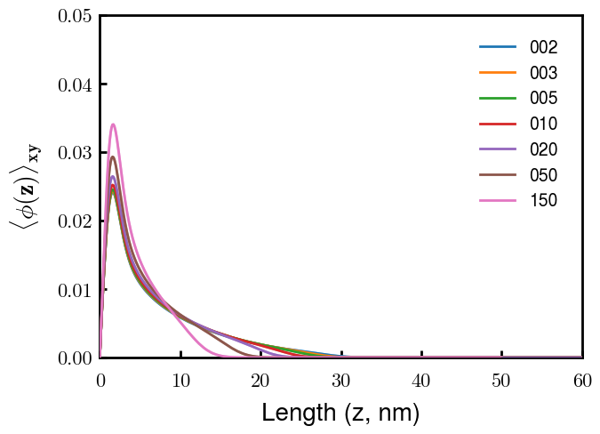
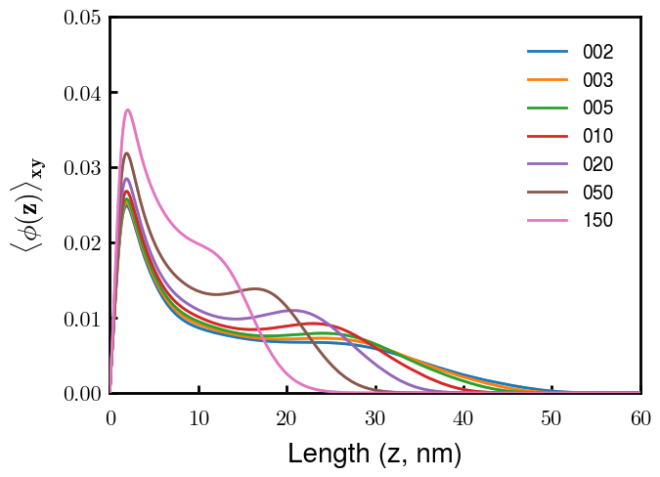
NFL
NFM
Next slide
Notes
pNFM running now; NFHb60v05c150 (cm225) running now
All non-phos same b,v
Phos L, M same as non-phos (few KsP)
Phos H 0.05 → 0.15 nm3
Potential improvements
Recheck pNFH(D2); no better option?
Recheck NFM; no better reasoning than b(s)?

Slide 2
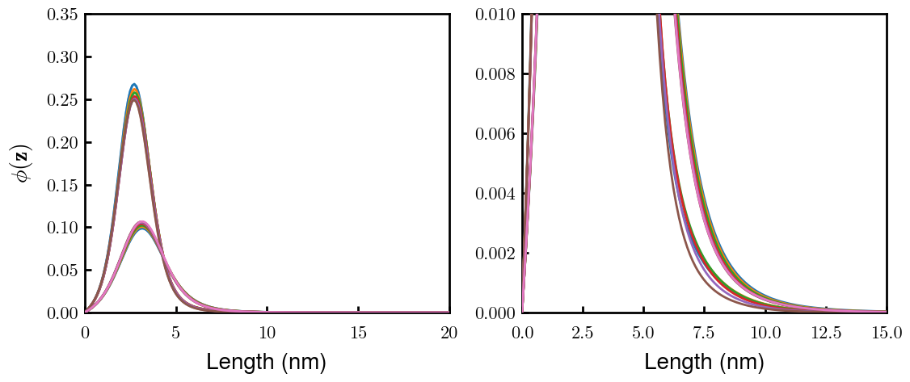
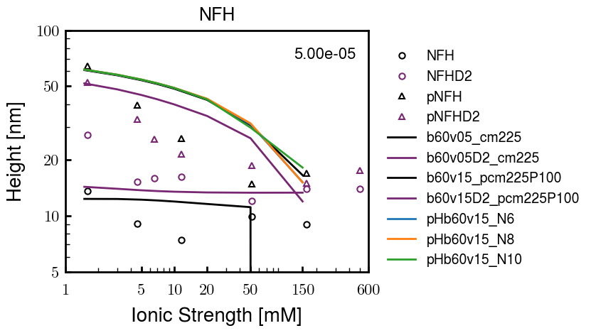
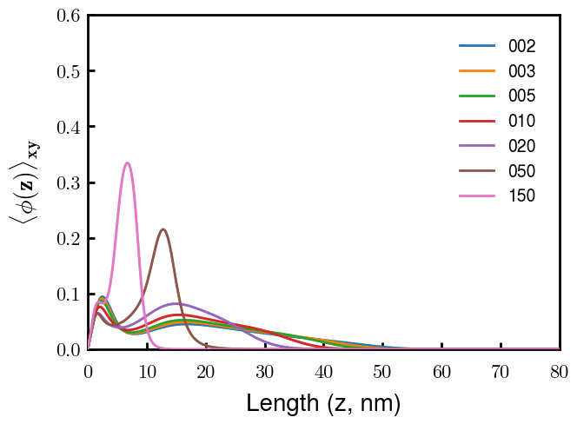
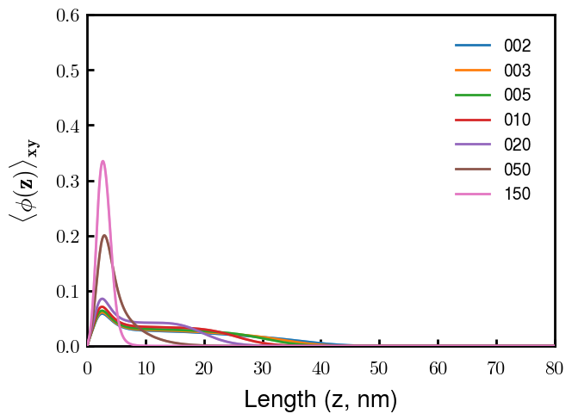
(p)NFH(D2)
NFH
NFHD2
pNFH
pNFHD2
(v = -1)
Points
v05 → v15 after phosphorylation
No condensed multilayer but worse fit

Slide 3
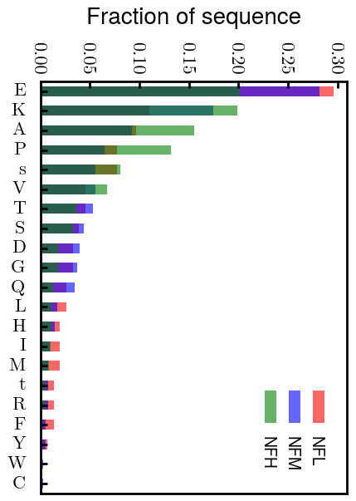
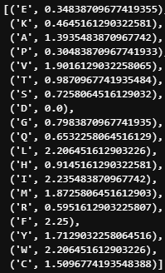
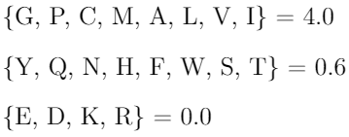
Chi (scaled)
Chi (BM 2023)
D: 3.65 (-1.00e);
E: 4.25 (-1.00e);
K: 10.53 (1.00e);
R: 12.48 (1.00e);
H: 6.00 (0.035e)
Biggest discrepancies between scaled and Zhulina: P (0.30 → 4.00), K (0.46 → 0.00), R (0.60 → 0.00)
(PKR has effect on pNFH; isolate P—currently seems too hydrophobic)

Slide 4
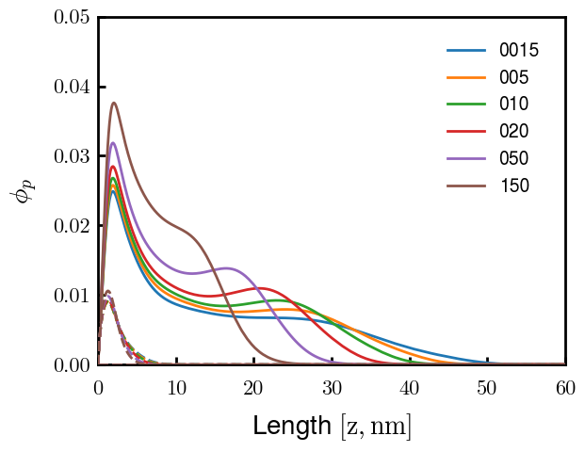
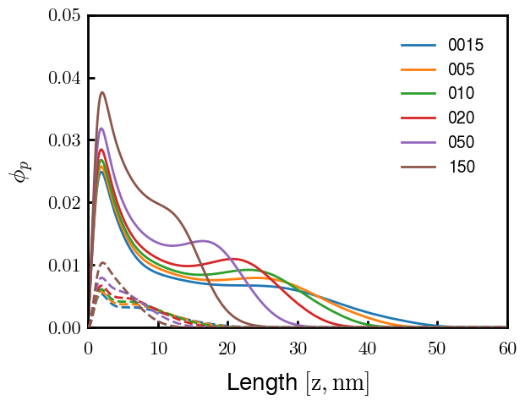
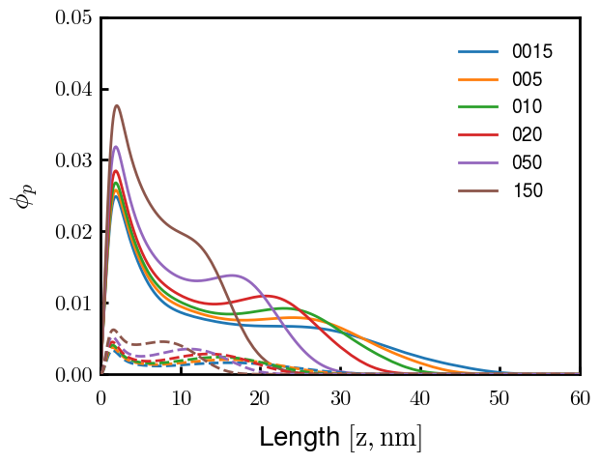
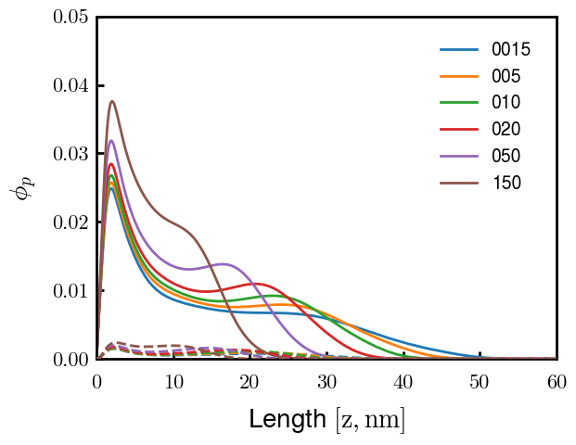
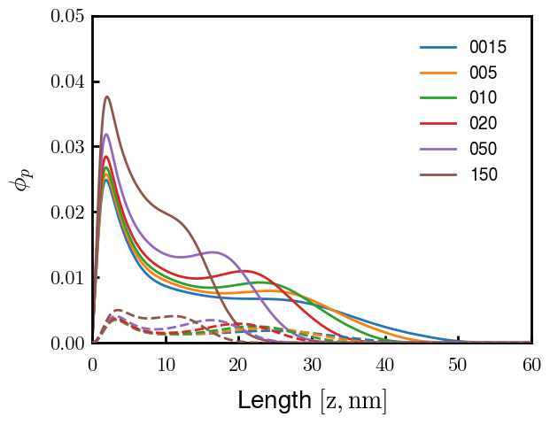

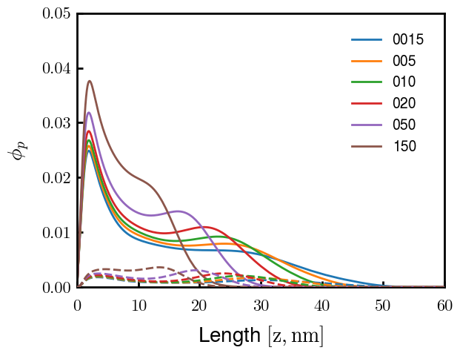
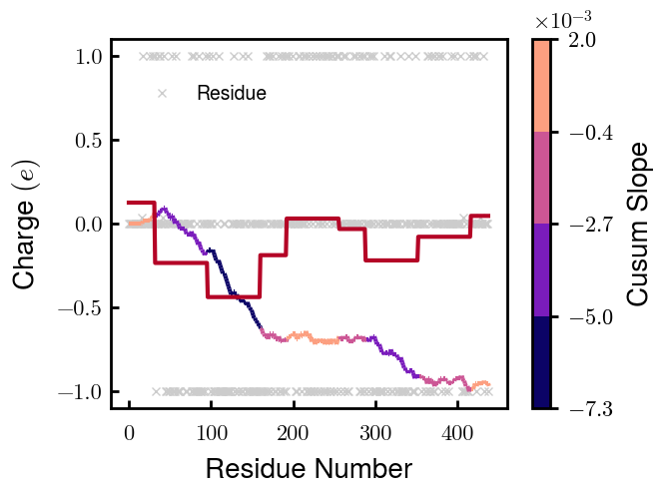

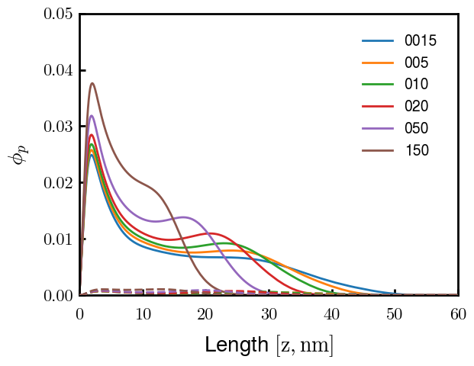
3
4
1
2
6
7
5
8
9

Slide 5
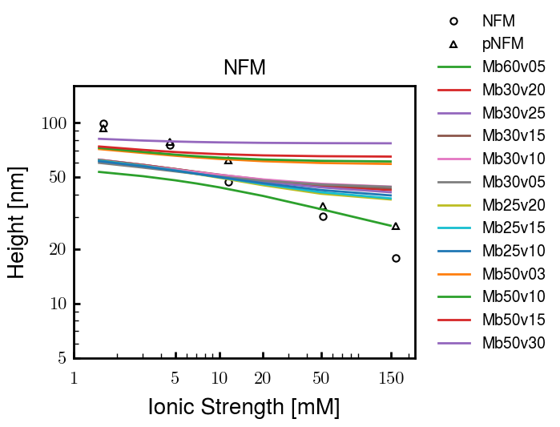
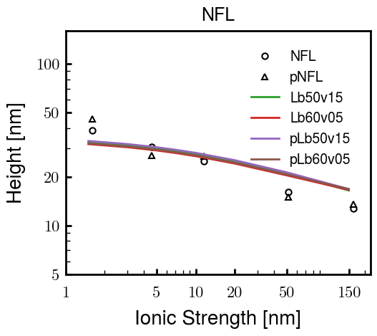
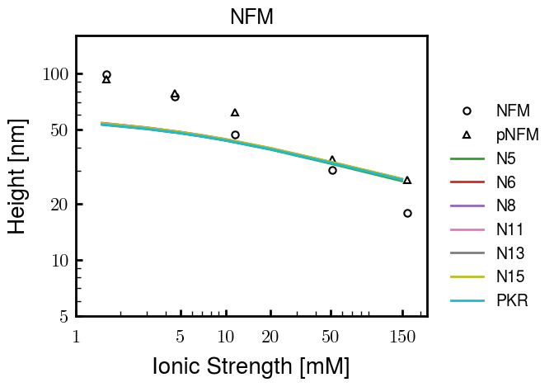
Other fits
pNFH P study next slide

Slide 6
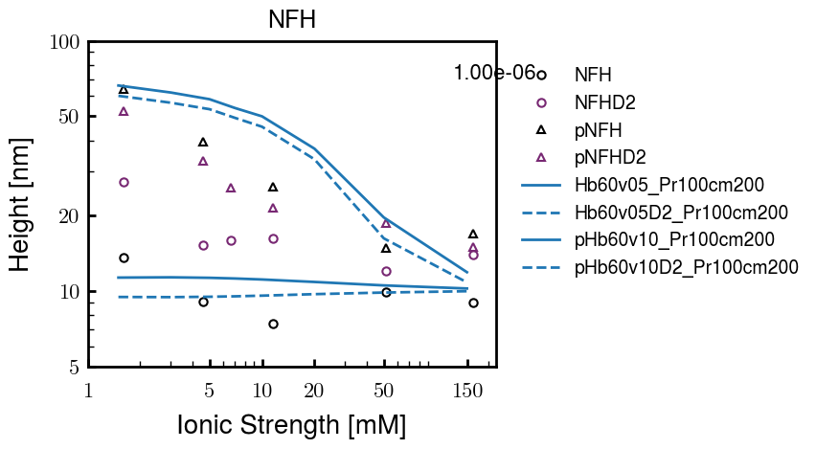
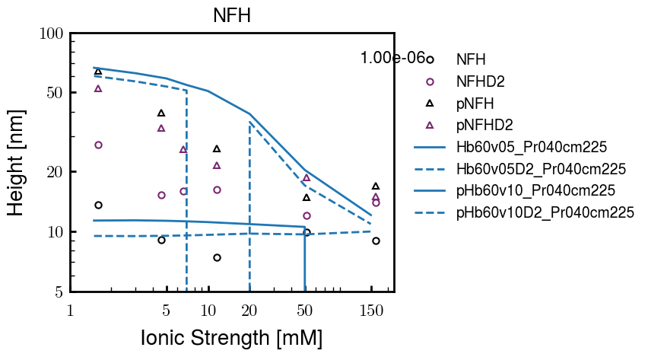

Slide 7
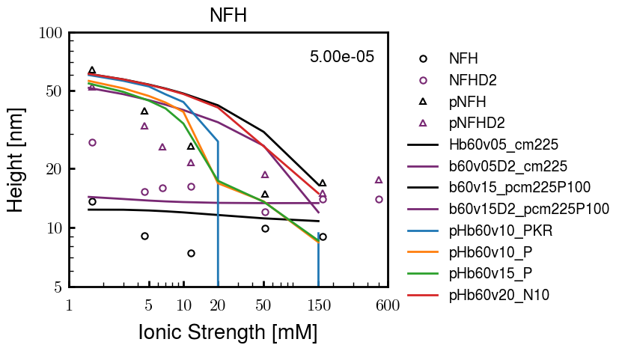
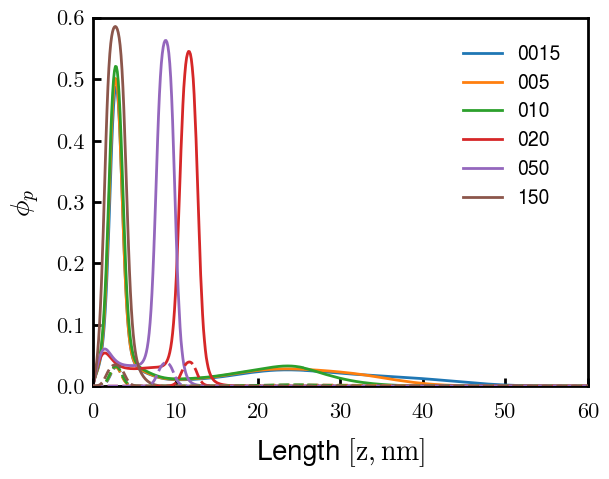
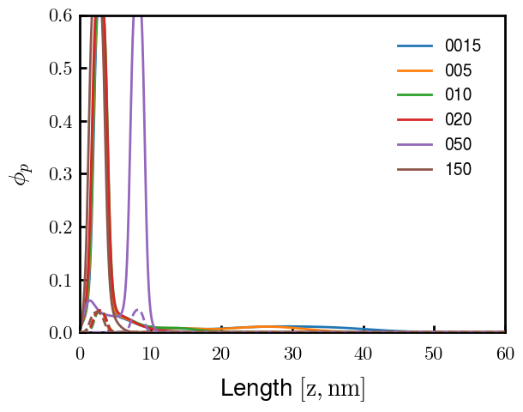
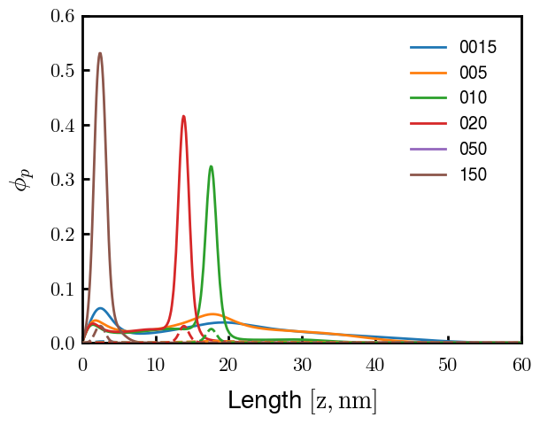
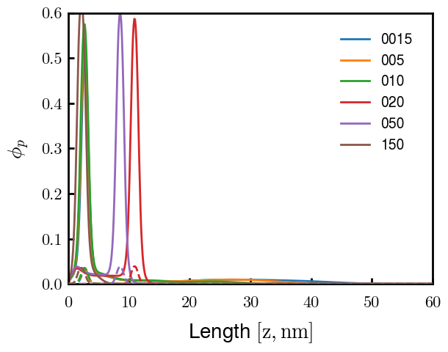
pHb60v15_PKR
pHb60v15_P
pHb60v10_PKR
pHb60v10_P
PKR identified as amino acids with high discrepancies between expt and Zhulina bins
P isolated and good trend (change P to max, 2.25)
Even though better H, some conformational changes. Try to avoid by decreasing (in prog).
Single outer peak may not be bad— “flower” conf?
At the very least, increase high cs height and check NFHD2 (and eventually NFL, NFM)
Ensure effect does not ruin NFH(D2) (after screening)

Slide 8
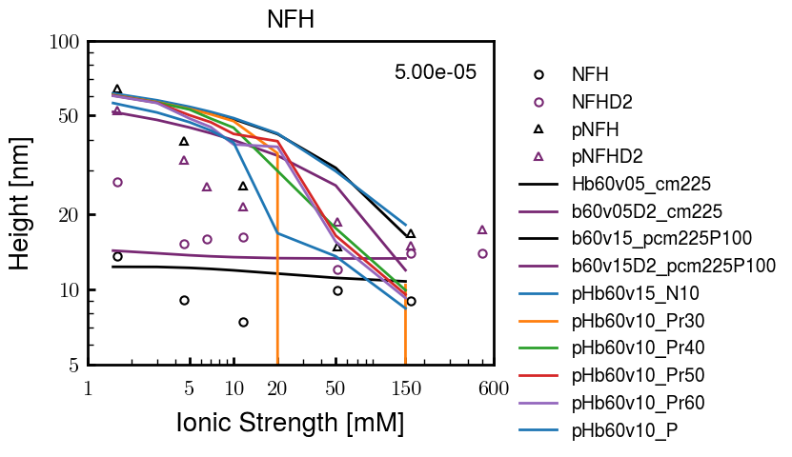
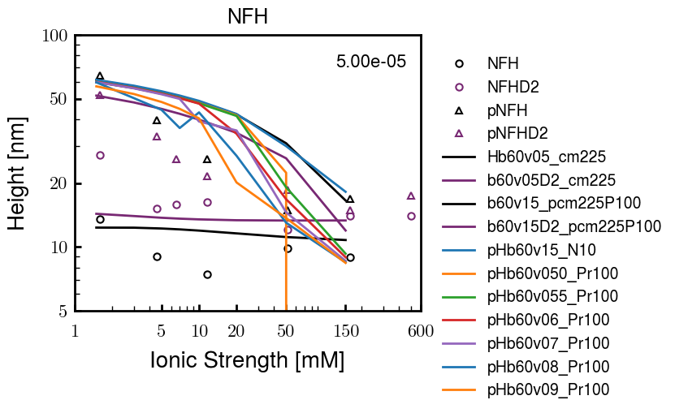
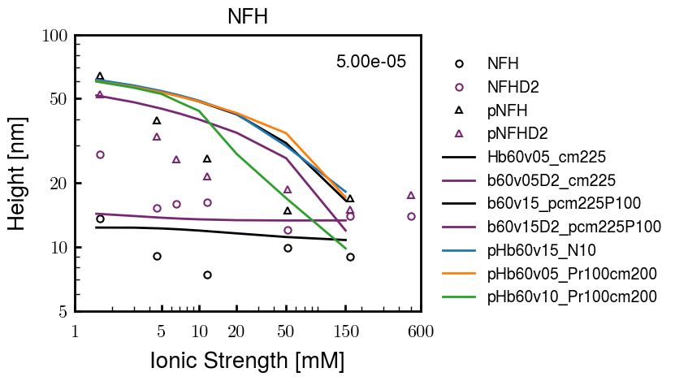

Slide 9
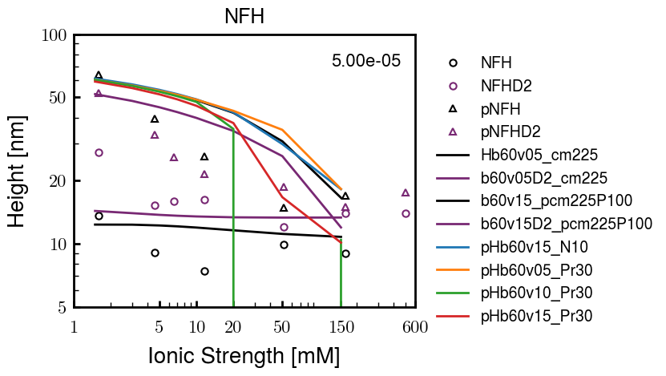
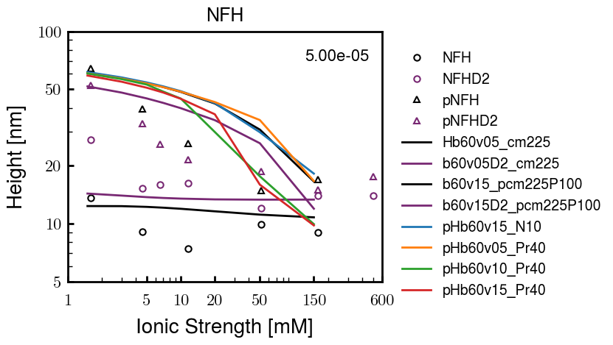
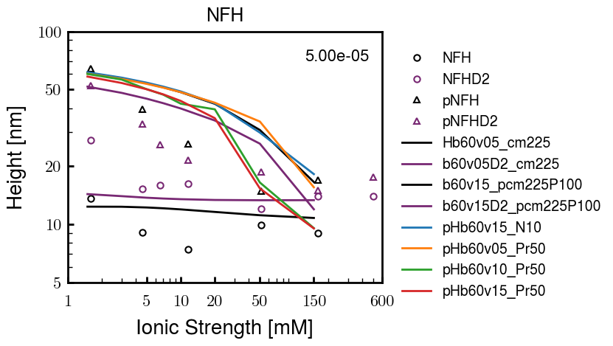
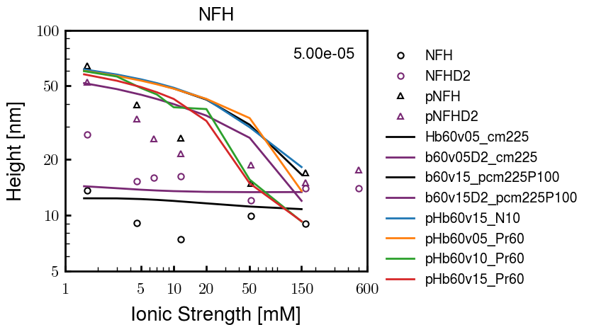
Pr100

Slide 10





Slide 11
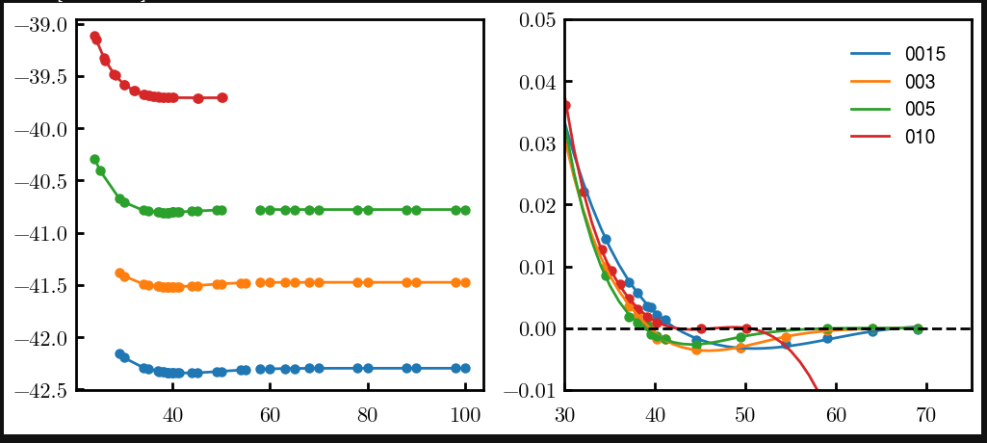
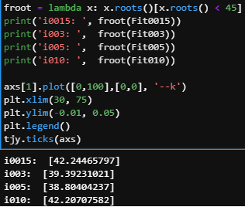
Try approaching surface

Slide 12




NFH (original); 31, 4
NFHD2; 40, 4
D2: delete 36-72
Rerun alg on D2
NFH (phos); 36, 4
NFHD2 (phos); 33, 4
Note: not currently doing this

Slide 13
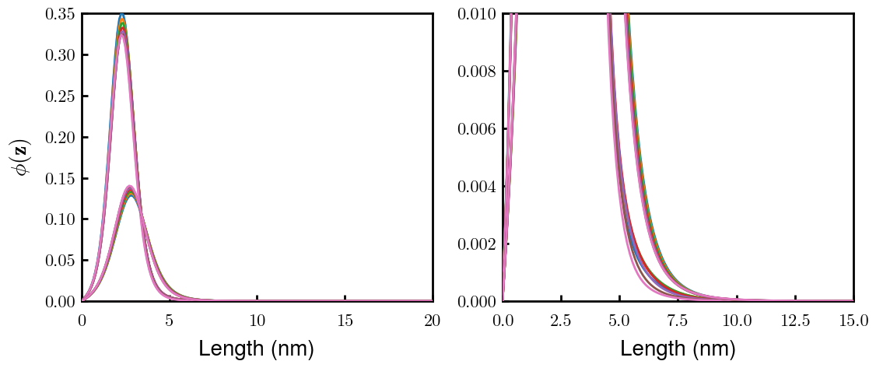
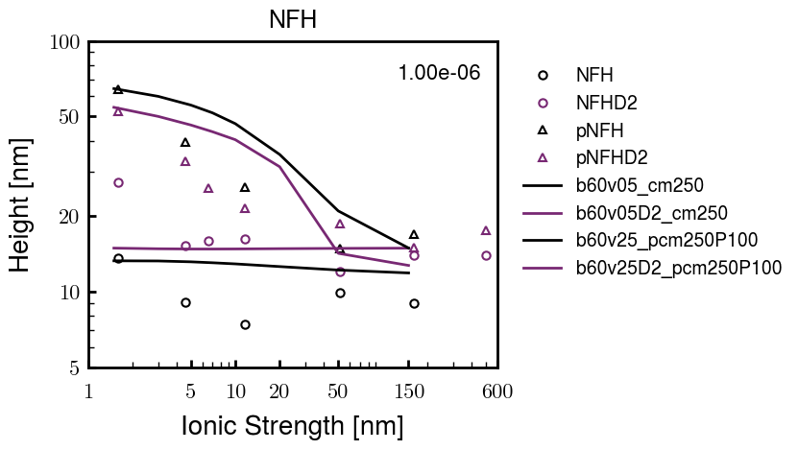
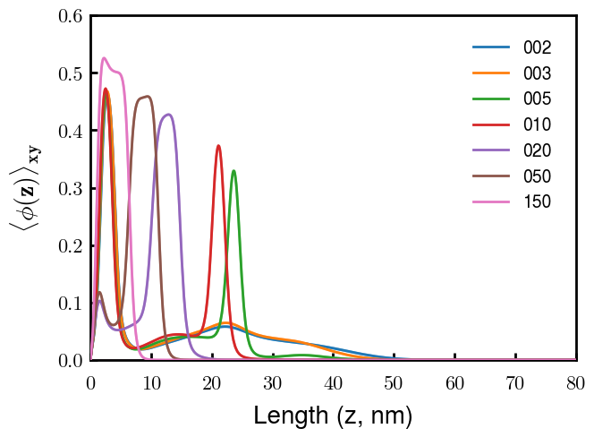
Best fit w/ consistent chi_max
NFH
NFHD2
pNFH
(v = -1)
Points
v05 → v25 after phosphorylation
Bilayer (trilayer for 5?) pNFH morphology

Slide 14
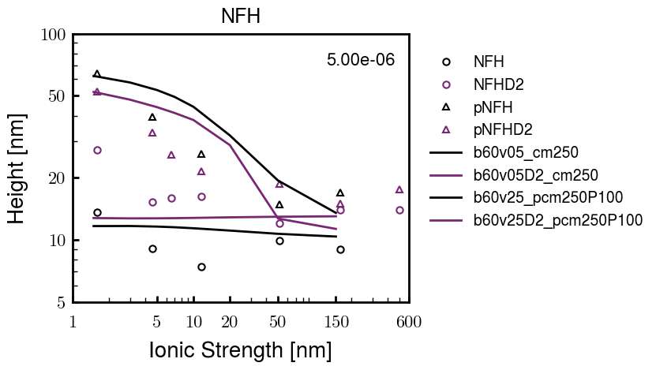
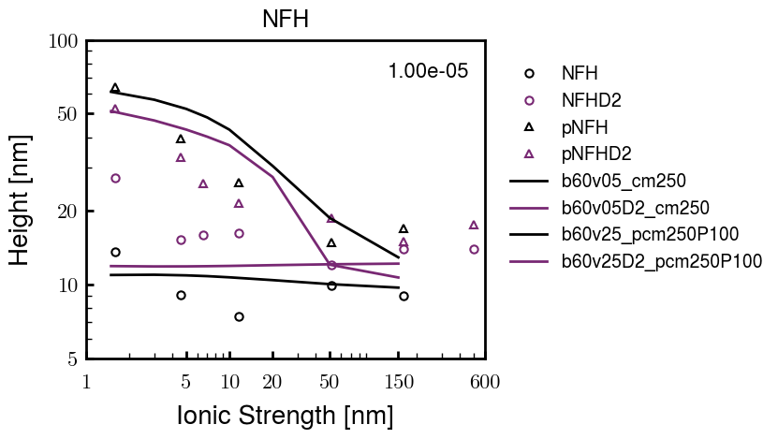
Same params as prev. w/ diff thresh

Slide 15
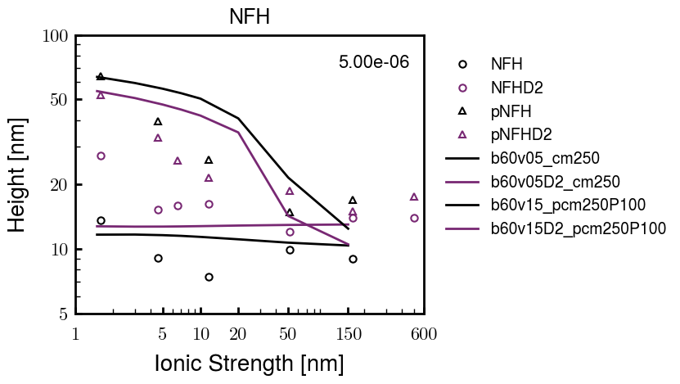
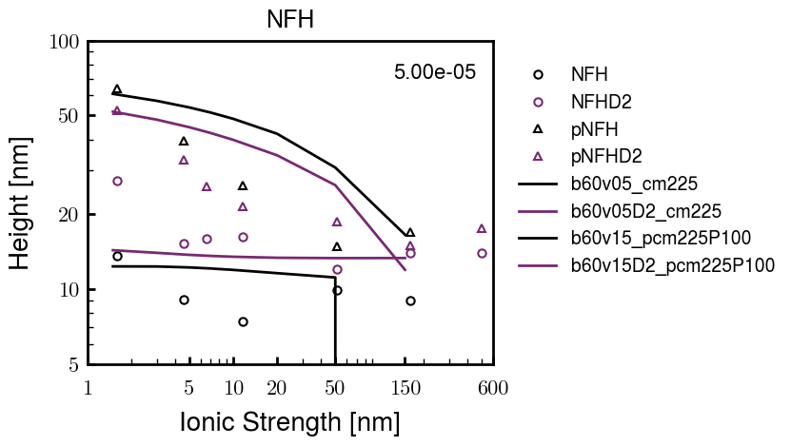
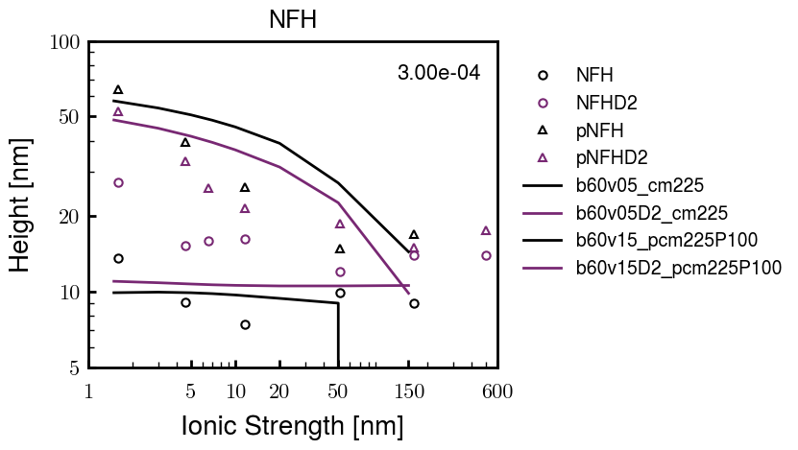
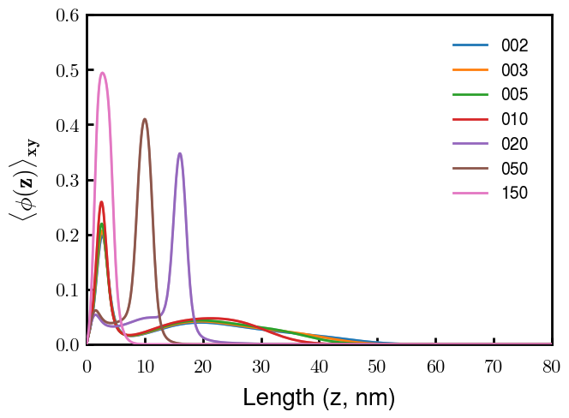
Find best without multilayer
pNFH
pNFH
(v = -1)
(v = -1)
Multilayer at 20

Slide 16
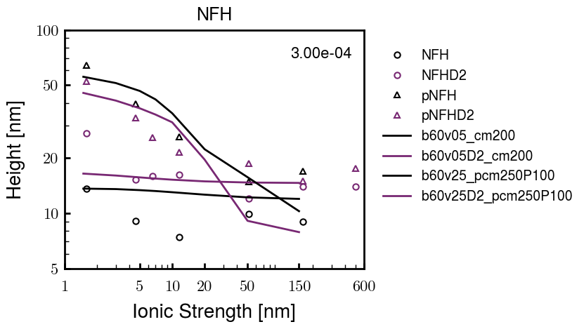
Best pNFH scaling fit (no regard to realistic)
pNFH
(v = -1)
Points
v05 → v25 after phosphorylation
cm200 → cm250 after phospho
Multilayer
Phospho < native

Slide 17






Native NFH

Slide 18







NFHD2

Slide 19




pNFH(D2)
4e-03

Slide 20





1e-06
4e-03
norm
4e-03
Try to bring pNFH down → {cmXX + PXX} only choice
norm
4e-03

Slide 21

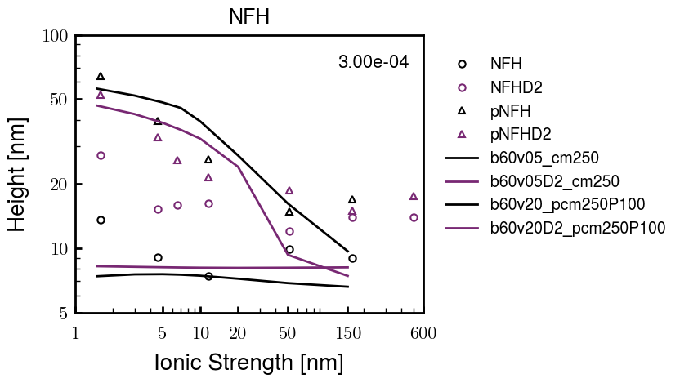


3e-04
3e-04
3e-04

Slide 22





Heights.params : b60v05 cm200
norm
1e-06
1e-05
1e-04
4e-03

Slide 23






Heights.params : b60v05 cm250
norm
ylog
norm
ylin
1e-06
1e-05
1e-04
5e-03

Slide 24




Heights.params: b60v10 cm{200, 225}
norm
1e-06
1e-05
1e-04
5e-03

Slide 25



Slide 26

 | Slope Bins 4 | Smear Count 25
Block number | Alpha w/ Henderson Hasselbalch | Chi Chi_max = 2.2
[0 50] | 0.040012 | 1.160000
[50 75] | -0.278451 | 0.720000
[75 125] | -0.519707 | 0.608000
[125 156] | -0.154453 | 0.529032

Slide 27

 | Slope Bins 4 | Smear Count 31
Block number | Alpha w/ Henderson Hasselbalch | Chi Chi_max = 2.2
[0 31] | 0.001103 | 0.922581
[31 62] | -0.386873 | 0.703226
[62 93] | -0.290146 | 0.967742
[93 496] | 0.037164 | 1.098759
[496 527] | -0.064533 | 0.819355
[527 620] | 0.010682 | 0.756989
[620 647] | -0.103326 | 0.696296

Slide 28






Previous
New

Slide 29





Slide 30


Response to stimuli given composition
Same data
Effect of composition given environment

Slide 31


NFL, pH 7.44, phos 1.5e (locs from LCMS)
Non-phos NFL
Block number | Alpha w/ Henderson Hasselbalch | Chi Chi_max = 3.2
[0 50] | 0.040012 | 1.540000
[50 75] | -0.278451 | 0.960000
[75 125] | -0.519707 | 0.868000
[125 156] | -0.154453 | 0.690323
 | Slope Bins 4 | Smear Count 25
Block number | Alpha w/ Henderson Hasselbalch | Chi Chi_max = 3.2
[0 50] | -0.019988 | 1.540000
[50 75] | -0.278451 | 0.960000
[75 125] | -0.519707 | 0.868000
[125 156] | -0.154453 | 0.690323

Slide 32

NFM, pH 7.44, phos 1.5e (locs from LCMS)
 | Slope Bins 4 | Smear Count 32
Block number | Alpha w/ Henderson Hasselbalch | Chi Chi_max = 3.0
[0 32] | 0.079143 | 1.275000
[32 64] | -0.186340 | 1.125000
[64 96] | -0.327964 | 1.181250
[96 160] | -0.460694 | 0.787500
[160 224] | -0.124999 | 1.115625
[224 288] | -0.023510 | 0.956250
[288 352] | -0.242085 | 1.003125
[352 384] | -0.031302 | 1.125000
[384 416] | -0.123860 | 1.050000
[416 438] | 0.046945 | 1.281818

Slide 33





Bin 3 NFM, pH 7.44, phos 1.5e (locs from LCMS)

Slide 34




Bin 5 NFM, pH 7.44, phos 1.5e (locs from LCMS)

Slide 35



Phos 2 NFM, pH 7.44, phos 2.0e (locs from LCMS)

Slide 36



Chi 2.5 NFM, pH 7.44, phos 2.0e (locs from LCMS)

Slide 37



NFM, pH 7.44, non-phos

Slide 38


NFH, pH 7.44, phos 1.5e (locs from LCMS)
 | Slope Bins 4 | Smear Count 36
Block number | Alpha w/ Henderson Hasselbalch | Chi Chi_max = 3.2 | Chi Chi_max = 3.0
[0 36] | 0.000945 | 1.266667 | 1.20000
[36 72] | -0.527455 | 0.900000 | 0.85000
[72 324] | -0.208376 | 1.729365 | 1.628571
[324 396] | -0.111195 | 1.416667 | 1.333333
[396 432] | -0.152824 | 1.344444 | 1.266667
[432 647] | -0.033955 | 1.077209 | 1.015814

Slide 39




Phos block dashed
Phos block dashed

Slide 40



Best are b3.0 v2.0 and b3.0 v3.0, but max H not high enough
Possible solutions:
Lower chi_max
Change aa_disc to have more charge
Force spectra?
Better for low salt, but high salt will melt brushes together

Slide 41



M1
pMx5

Slide 42



b3.00; v1, 2
b4.00; v2, 2.5, 3, 5, 10
b5.00; v3, 10, 15, 40
53 Nk
39 Nk
32 Nk

Slide 43
Binary results

Slide 44



Matrix Approach
Updated 04/04/2023

Slide 45














H Vol decrease (by v)
H Vol decrease (by b)
Desired “linearity” by tuning /thresh/ based on polymer density of expelled NFL
L Vol decrease (by b)
Comes at severe cost of overall height. Have to minimize outer concentration to approach pure thresh of 1e-06

Slide 46














H Vol decrease (by v)
H Vol decrease (by b)
Chimax 3.5
Desired “linearity” by tuning /thresh/ based on polymer density of expelled NFL
L Vol decrease (by b)
Comes at severe cost of overall height. Have to minimize outer concentration to approach pure thresh of 1e-06

Slide 47








F (3.5)
Chimax 3.5
Chimax 3.0
Scaled by 1.5
Scaled by 1.6
Scaled by 1.6
Scaled by 1.5
Scaled by 1.5
Scaled by 1.5
Scaled by 1.8
Scaled by 1.8

Slide 48
















Last test: same stiffness factor (b^3/v0) but with varying total volume

Slide 49












H Vol decrease (by v)
H Vol decrease (by b)
a2C_30
a2D_30
a2E_30
Rerun for Cs
b1C_30
b1D_30
b1E_30
L Vol decrease (by b)
a1C_30
a1D_30
a1E_30
g1C_30
g1D_30
g1E_30
Rerun for Cs

Slide 50












H Vol decrease (by v)
H Vol decrease (by b)
a2C
a2D
a2E
b1C
b1D
b1E
Block 4 (NFL end)
L Vol decrease (by b)
a1C
a1D
a1E
g1C
g1D
g1E

Slide 51









H Vol decrease (by v)
Chimax 3.5
H Vol decrease (by b)
a2C_30
a2D_30
a2E_30
b1C_30
b1D_30
b1E_30
L Vol decrease (by b)
a1C_30
a1D_30
a1E_30
g1C_30
g1D_30
g1E_30

Slide 52







For i as L and H:
Pure height profiles
Mixed height profiles
Current L library
Current H library
Skip; marginal increase in vol prob not enough
Move onto chi3.0; larger NFL vol library

Slide 53





NFL
All plotting wrong L pure; look only at purp
NFH
H volume too low to neutralize L (v = 31 nm3/c)

Slide 54







H volume v = 60 nm3/c

Slide 55







H volume too low to neutralize L

Slide 56










NFH, V = 70
L30

Slide 57





NFH & NFL v = 0.15
a2D
b1D
g1D

Slide 58





Based on NFH b5v15c3, apply VL = VH
NFL and NFH are from same amino acids but diff chain lengths. Should VL = VH?
L30 / H70
L80 / H20
L30 / H70
L80 / H20

Slide 59






L30 / H70
L80 / H20
L30 / H70
L80 / H20

Slide 60
L Fitting

Slide 61


VL = VH

Slide 62







Try b change, v same as H (0.15)
Phi unrealistic (?)
Phi unrealistic
Phi very unrealistic
Phi very unrealistic

Slide 63






Try similar params to H
5.6
11.2
16.8
28
56
7.5
11.25
18.75

Slide 64







Try similar params to H, b0.36
7.8
15.6
23.4
31.2
Unrealistic vol
Not very sensitive to v; not high enough to intersect neighboring chains (function of b and sigma)

Slide 65


Continuation from prev params

Slide 66







v2.7 and some fine
b1.50 v2.7 c3.2
b1.75 v2.7 c3.2
b1.75 v2.5 c3.2
b1.75 v2.5 c3.0
b2.0 v2.7 c3.2
b2.25 v2.7 c3.2
b2.50 v2.7 c3.2
Phi too small to decrease v0

Slide 67










b2.0 v10.0 c3.0
b2.0 v8.0 c3.0
b2.0 v6.0 c3.0
b2.0 v4.0 c3.0
b2.0 v2.0 c3.0
Phi limit
b1.8 v10.0 c3.0
b1.8 v8.0 c3.0
b1.8 v6.0 c3.0
b1.8 v3.0 c3.0
b1.8 v2.0 c3.0
Phi limit

Slide 68





b1.6 v10.0 c3.0
b1.6 v8.0 c3.0
b1.6 v6.0 c3.0
b1.6 v2.0 c3.0
b1.6 v1.5 c3.0
Phi limit

Slide 69









b2.0 v2.7 c3.2
b3.0 v3.5 c3.5
b3.0 v7.0 c3.5
b3.0 v7.0 c3.0
Phi too small
Phi too small to decrease v0
b4.0 v12.0 c3.0
b5.0 v20.0 c3.0
b5.0 v20.0 c4.0
b5.0 v5.0 c3.0
b5.0 v10.0 c3.0
Phi too small to decrease v0

Slide 70





v20
b5.0 v20.0 c3.0
b4.5 v20.0 c3.0
b4.0 v20.0 c3.0
b3.5 v20.0 c3.0
v10
b5.0 v10.0 c3.0
b4.0 v10.0 c3.0
b3.0 v10.0 c3.0
b2.0 v10.0 c3.0

Slide 71




b2.00 v2.70 c3.20
b2.00 v2.75 c3.20

Slide 72
NFH fitting (from NFL best fit)

Slide 73








b1.00, v0.50, c3.2
b2.00, v4.00, c3.2, th2.5e-02
b1.00, v2.00, c3.2
b1.00, v1.00, c3.2

Slide 74
Mixture

Slide 75



Slide 76


b = 0.75

Slide 77





Slide 78
b = 1.0

Slide 79





Slide 80
b = 1.25

Slide 81




Chi 2.6
Bad vol frac

Slide 82








b25v0
b25v1
b25v2
b25v3

Slide 83




Chi 2.8
Bad vol frac

Slide 84





Slide 85
b = 1.50

Slide 86






Chi 2.8
Bad vol frac

Slide 87





Slide 88

b = 2.00
v4 = 0.25*b^3

Slide 89


Bad vol frac

Slide 90



Slide 91
Fine tune

Slide 92



b1.25, v1.95, c3.0
b1.50, v3.38, c3.0
b2.00, v4.00, c3.0
Norm seems to capture kinked behavior

Slide 93




Slide 94



b1.25, v1.95, c3.2
b1.50, v3.38, c3.2
b2.00, v4.00, c3.2

Slide 95




Slide 96


b1.25
b1.50
b2.00
c2.8
c3.0
c3.2

